Slide 1

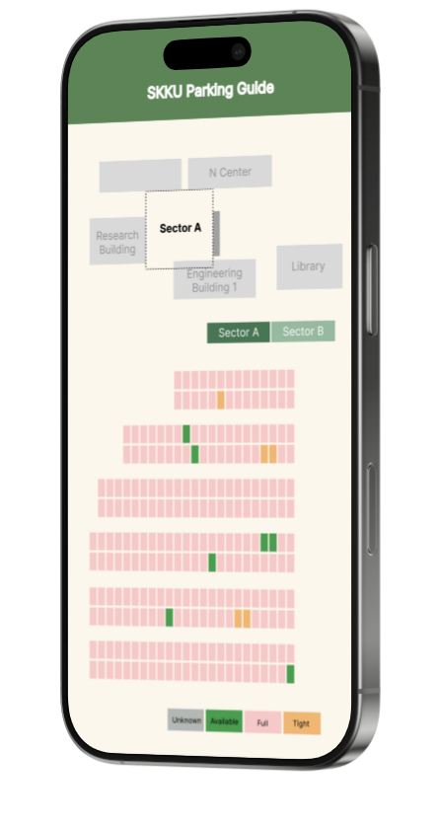
SKKU Parking Guide
Midterm presentation
캡스톤프로젝트 Team I-dle
김세헌
김형진
노하연
박인찬

Slide 2





Contents
1
2
3
4
5
Play & Role
Progress Update
Design UI/UX
Implementation & Challenges
Scheduled Plans

Slide 3
Kim Seheon
Kim Hyeongjin
Noh Hayeon
Play & Role
Team Leader
Parking Spot Coordinates Labeling
Model Modifying
Front-end Development
Database Application Design
Park Inchan
Vision processing
Data Collecting
Model Modifying
Vision processing
Data Collecting
Model Modifying

Slide 4





Progress Update
Week 1~5
Week 6~7
Week 9
Week 10
Week 11~12
Proposal Writing
Data Collecting
UI/UX Design
Model Train
Data Preprocessing
Front-end Development
Model Enhancement
(Space + Car)
Integrate Model
with App
Testing and
Revision

Slide 5
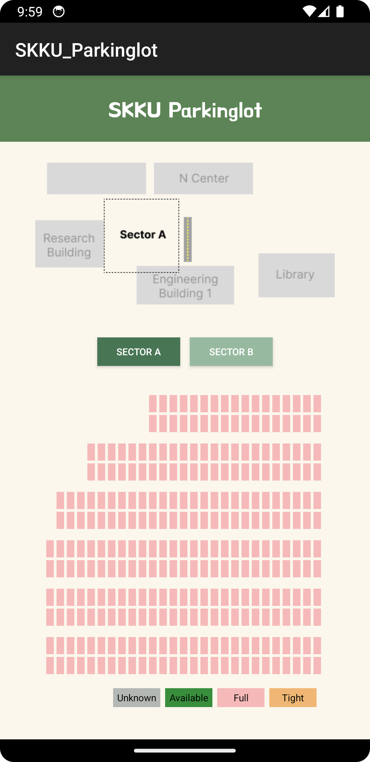
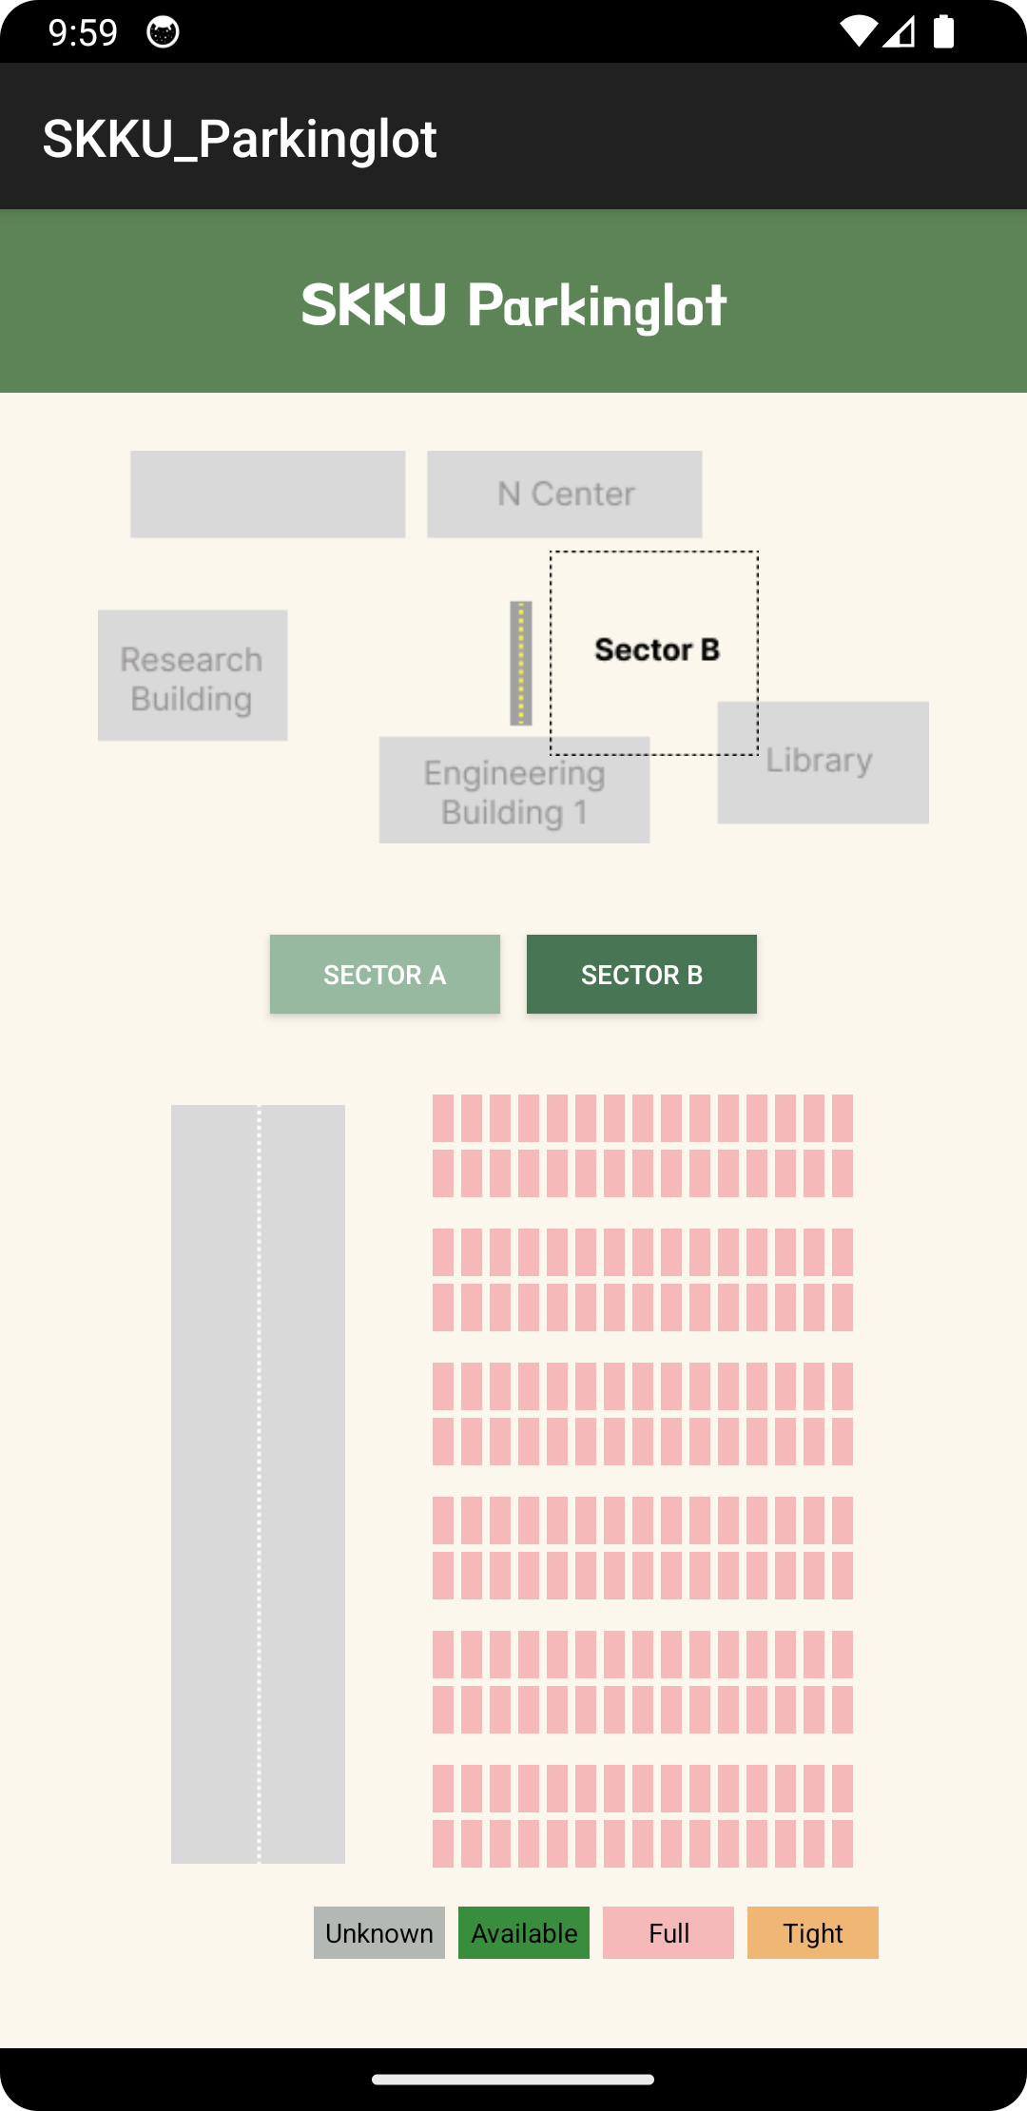
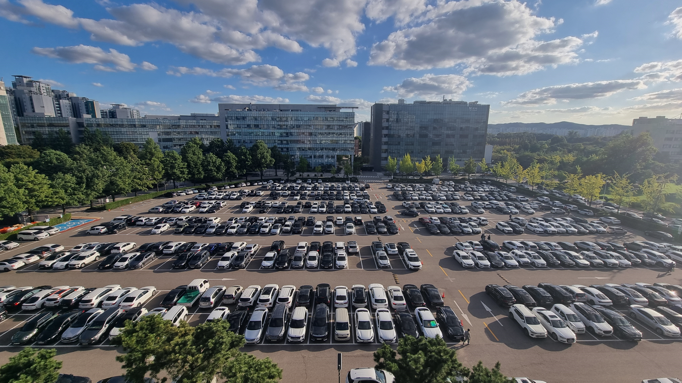
UI/UX Design

Slide 6
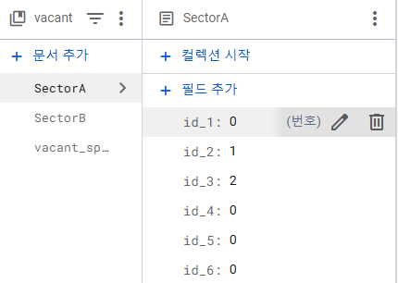

Implementation

Slide 7
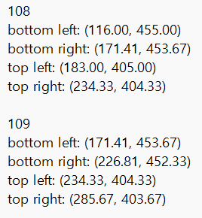
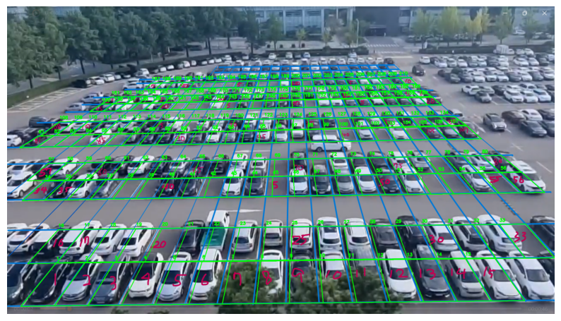

Implementation
1. Convert the coordinates.txt into yolo format {x_center, ycenter, width, height}

Slide 8
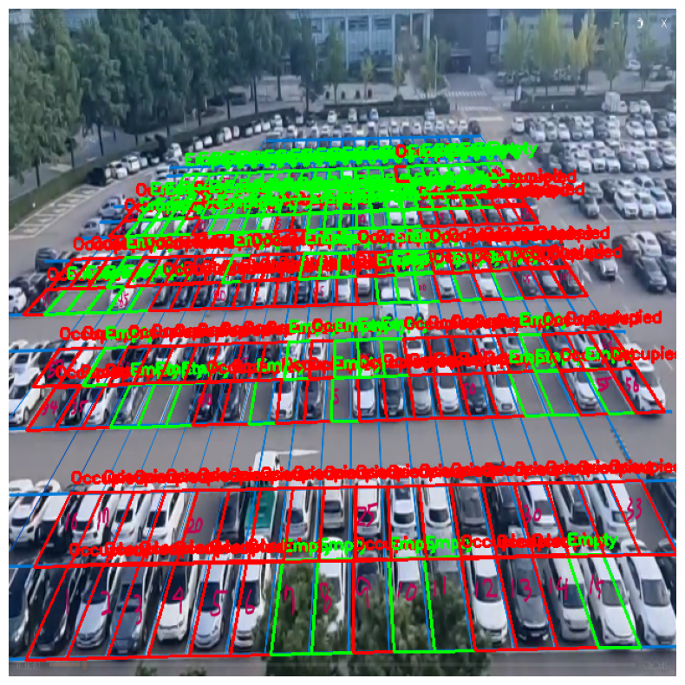
Implementation
2. Match the detected car with coordinates
Occupied: center point is in the parkinglot spots
Empty: no center point matches the parkinglot spots

Slide 9
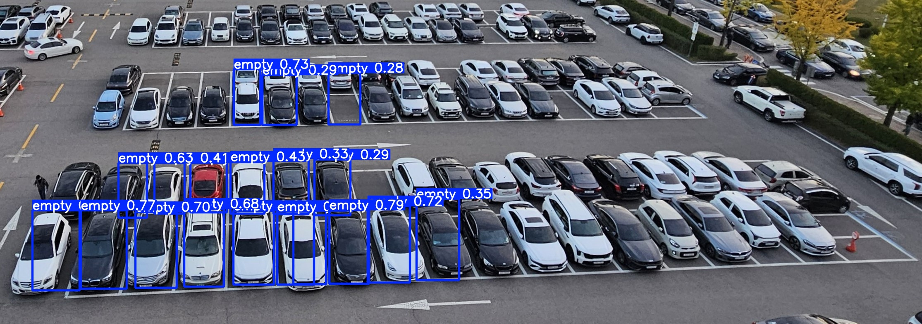
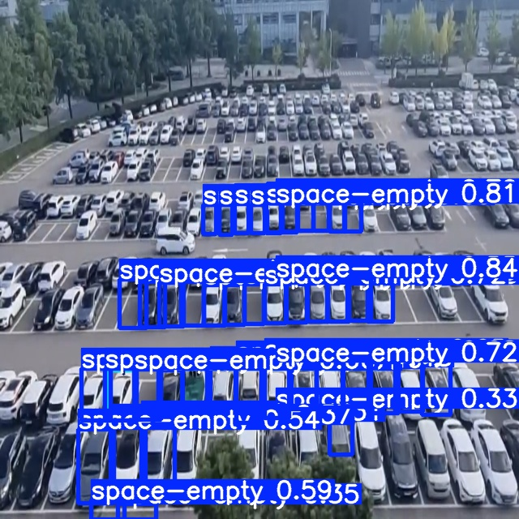
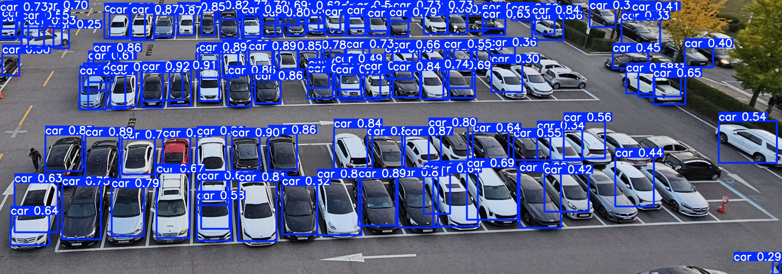
Dealing with Challenges
Previous challenges:
trained model did not work
with our real image
Solutions:
Test with smaller cropped image
2. Train with only ‘car’ label dataset

Slide 10

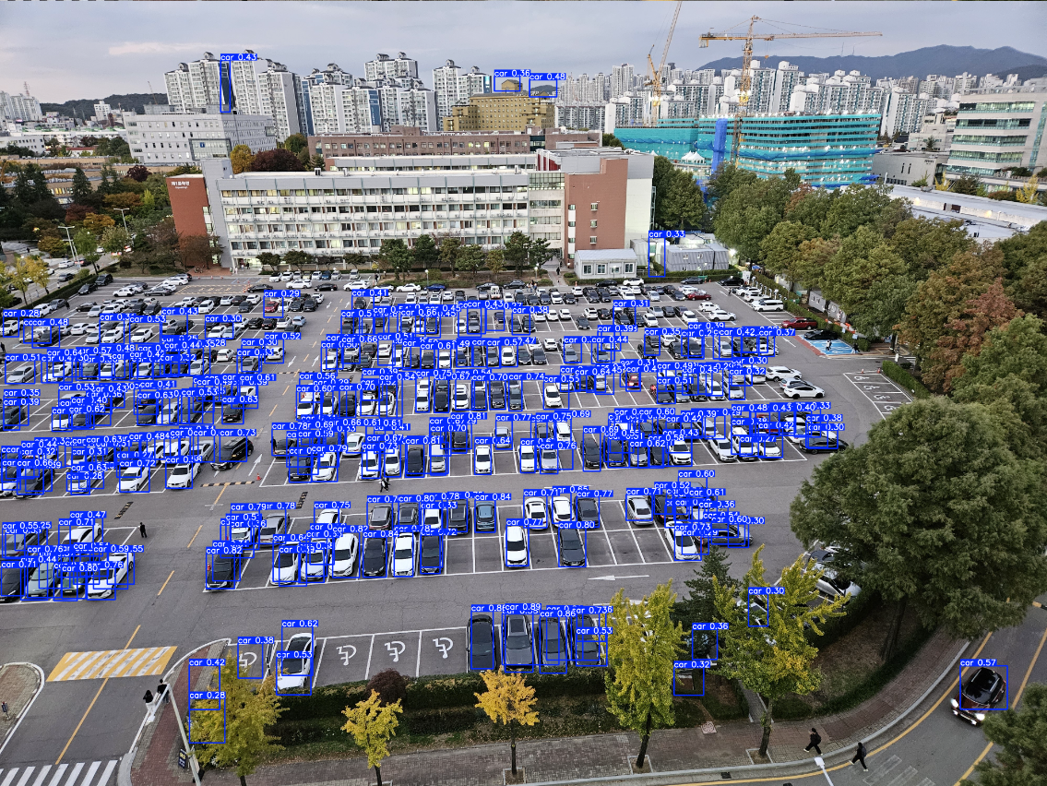

Dealing with Challenges
Solutions:
3. 2-Side view detection
<Engineering Building View>
<Pharmeaceutical Building View>

Slide 11
Challenges & Limitations
Overlap of detected car
=> raise the standard for the proportion of overlapping areas
2. Hard to distinguish large cars
=> Adjust the car’s coordinate ratio to make the car size constant and compare it

Slide 12
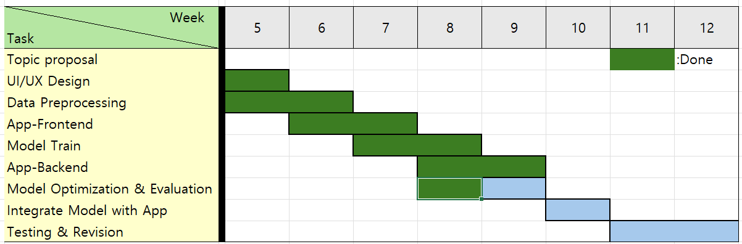
Scheduled Plan
What we’ve done
UI/UX Design
App-Frontend
App-Backend
Data Preprocessing
Model Train
Model Optimization
What we’re going to do
Model Evaluation
Integrate Model with APP
System Integration

Slide 13
Thank you

